Slide 1
Computer Vision in Cell Biology
Gaudenz Danuser, 2011
DOI: 10.1016/j.cell.2011.11.001

Slide 2
Developments in Image Processing
Image Processing: manipulation of a digitized image, especially to improve image quality and/or to emphasize a specific aspect of the image

Slide 3
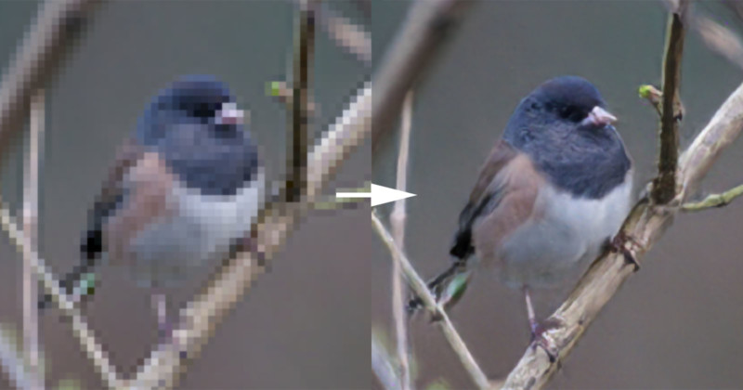
Developments in Image Processing
Image Processing: manipulation of a digitized image, especially to improve image quality and/or to emphasize a specific aspect of the image
Color & Contrast Enhancement
https://petapixel.com/2017/11/01/photo-enhancement-starting-get-crazy/

Slide 4
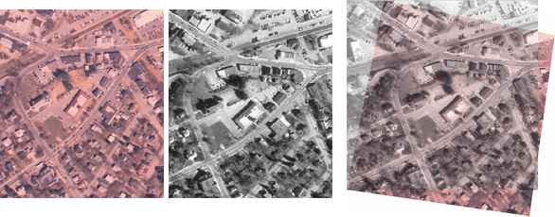
Developments in Image Processing
Image Processing: manipulation of a digitized image, especially to improve image quality and/or to emphasize a specific aspect of the image
Color & Contrast Enhancement
Image Registration
https://petapixel.com/2017/11/01/photo-enhancement-starting-get-crazy/
https://www.mathworks.com/discovery/image-registration.html

Slide 5
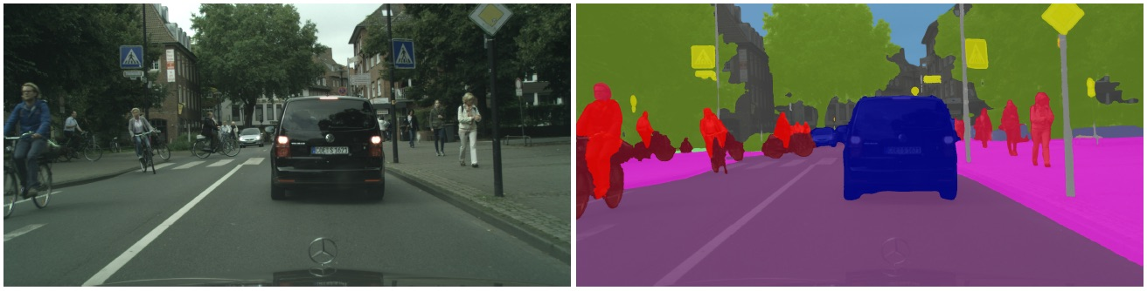
Developments in Image Processing
Image Processing: manipulation of a digitized image, especially to improve image quality and/or to emphasize a specific aspect of the image
Color & Contrast Enhancement
Image Registration
https://petapixel.com/2017/11/01/photo-enhancement-starting-get-crazy/
https://www.mathworks.com/discovery/image-registration.html
Image Segmentation
http://vladlen.info/publications/feature-space-optimization-for-semantic-video-segmentation/

Slide 6
Image Processing vs. Image Analysis
While image processing may prepare an image for analysis, image processing itself does not interpret image content
Advances in image processing have surpassed advances in image analysis
Heavy reliance on human visual inspection

Slide 7
Image Processing vs. Image Analysis
While image processing may prepare an image for analysis, image processing itself does not interpret image content
Advances in image processing have surpassed advances in image analysis
Heavy reliance on human visual inspection
Computer vision: interdisciplinary field concerned with automatic extraction, analysis, and understanding of useful information from a single image/sequence of images
Goal of computer vision programs: to replace the human observer in complex image analysis tasks
Earliest application of computer vision program: karyotyping (Gilbert, 1966; Castleman et. al., 1976)

Slide 8
Contributions of Computer Vision Programs in Imaged-Based Cell Biology
1. Automation
2. Completeness
3. Access to Invisible Image Information

Slide 9
Contribution 1: Automation
Automated image analysis enhances efficiency and accuracy

Slide 10
Contribution 1: Automation
Automated image analysis enhances efficiency and accuracy
Example: Quantitative Morphological Signatures Define Local Signaling Networks Regulating Cell Morphology (Bakal et. al., 2007)

Slide 11
Contribution 1: Automation
Automated image analysis enhances efficiency and accuracy
Example: Quantitative Morphological Signatures Define Local Signaling Networks Regulating Cell Morphology (Bakal et. al., 2007)
Screened hundreds of genes and double-stranded RNA
Goal: Determine which genes give rise to distinct aspects of cellular morphology

Slide 12
Contribution 1: Automation
Automated image analysis enhances efficiency and accuracy
Example: Quantitative Morphological Signatures Define Local Signaling Networks Regulating Cell Morphology (Bakal et. al., 2007)
Screened hundreds of genes and double-stranded RNA
Goal: Determine which genes give rise to distinct aspects of cellular morphology
Imaged fluorescently-labeled cells, analyzed the cell boundary shape and texture as well as light intensity of the cell interior
Extracted 145 relevant features for each individual cell

Slide 13
Contribution 1: Automation
Automated image analysis enhances efficiency and accuracy
Example: Quantitative Morphological Signatures Define Local Signaling Networks Regulating Cell Morphology (Bakal et. al., 2007)
Screened hundreds of genes and double-stranded RNA
Goal: Determine which genes give rise to distinct aspects of cellular morphology
Imaged fluorescently-labeled cells, analyzed the cell boundary shape and texture as well as light intensity of the cell interior
Extracted 145 relevant features for each individual cell
Utilized a set of neural networks to classify single-cell morphologies based on the features extracted
Identify local signaling networks that regulate cell shape and migration in a robust, cost-effective manner

Slide 14

Contribution 1: Automation
Automated image analysis enhances efficiency and accuracy
Example: Quantitative Morphological Signatures Define Local Signaling Networks Regulating Cell Morphology (Bakal et. al., 2007)
Screened hundreds of genes and double-stranded RNA
Goal: Determine which genes give rise to distinct aspects of cellular morphology
Imaged fluorescently-tagged cells, analyzed the cell boundary shape and texture as well as light intensity of the cell interior
Extracted 145 relevant features for each, individual cell
Utilized a set of neural networks to classify single-cell morphologies based on the features extracted
Identify local signaling networks that regulate cell shape and migration in a robust, cost-effective manner
https://bhtechconnection.com/it-advice-group/skeleton-computer/

Slide 15
Contribution 2: Completeness
Human image event selection is susceptible to incomplete analysis, and thus biased interpretations of the results
Completeness in computer vision systems allows for…

Slide 16
Contribution 2: Completeness
Human image event selection is susceptible to incomplete analysis, and thus biased interpretations of the results
Completeness in computer vision systems allows for…
Capturing of all possible heterogeneous cellular behaviors,

Slide 17
Contribution 2: Completeness
Human image event selection is susceptible to incomplete analysis, and thus biased interpretations of the results
Completeness in computer vision systems allows for…
Capturing of all possible heterogeneous cellular behaviors,
Detection of behavioral changes/events in cellular subpopulations under distinct experimental conditions that is more objective than image event selection by humans, and

Slide 18
Contribution 2: Completeness
Human image event selection is susceptible to incomplete analysis, and thus biased interpretations of the results
Completeness in computer vision systems allows for…
Capturing of all possible heterogeneous cellular behaviors,
Detection of behavioral changes/events in cellular subpopulations under distinct experimental conditions that is more objective than image event selection by humans, and
Detection of extremely rare but significant image events

Slide 19
Contribution 2: Completeness
Human image event selection is susceptible to incomplete analysis, and thus biased interpretations of the results
Completeness in computer vision systems allows for…
Capturing of all possible heterogeneous cellular behaviors,
Detection of behavioral changes/events in cellular subpopulations under distinct experimental conditions that is more objective than image event selection by humans, and
Detection of extremely rare but significant image events
Computer vision systems provide a better understanding of complex biological pathways and their pleiotropic effects with complete image data extraction

Slide 20
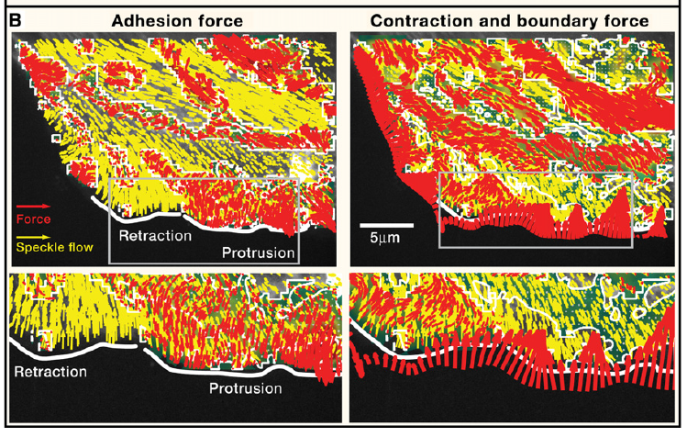
Contribution 3: Access to Invisible Image Information
Computer vision programs can be combined with mathematical models to explain “invisible” processes and observed image events
(Ji et. al 2008)

Slide 21
Contribution 3: Access to Invisible Image Information
Computer vision programs can be combined with mathematical models to explain “invisible” processes and observed image events
Example: Ji et. al., 2008
Computer tracking program used to extract speckle flows of actin filaments (yellow)
(Ji et. al 2008)

Slide 22
Contribution 3: Access to Invisible Image Information
Computer vision programs can be combined with mathematical models to explain “invisible” processes and observed image events
Example: Ji et. al., 2008
Computer tracking program used to extract speckle flows of actin filaments (yellow)
Mathematical model coupled with program to estimate the forces that must be exerted to explain the speckle flows observed (red)
(Ji et. al 2008)

Slide 23
The Association Paradigm vs. The Integrator Paradigm
The Association Paradigm
Humans capable of associating observed images with memory of previous visual experiences and interpret images with relative ease
Memory bank of previous visual experiences is IMMENSE
Difficult to train a computer vision system with a full array of visual experiences that may occur within an image

Slide 24
The Association Paradigm vs. The Integrator Paradigm
The Association Paradigm
Humans capable of associating observed images with memory of previous visual experiences and interpret images with relative ease
The Integrator Paradigm
Limitations of the human observer: subjectivity
When decision requires large, integrated analysis, computer vision is superior
Computer vision systems found to outperform humans in 1.) pattern recognition (Murphy et. al. 2003) and 2.) particle tracking (Reid, 1979)
Memory bank of previous visual experiences is IMMENSE
Difficult to train a computer vision system with a full array of visual experiences that may occur within an image

Slide 25
Machine Learning in Cell Biology-Teaching Computers to Recognize Phenotypes
Christoph Sommer and Daniel W. Gerlich, 2013
DOI: 10.1242/jcs.123604

Slide 26
Machine Learning in Bioimaging
Many algorithms have been developed for various image analysis tasks

Slide 27
Machine Learning in Bioimaging
Many algorithms have been developed for various image analysis tasks
Problem: many of these image analysis algorithms have been developed for specific experiments
Application to different experiments can require retuning of parameters and/or reprogramming of software

Slide 28
Machine Learning in Bioimaging
Many algorithms have been developed for various image analysis tasks
Problem: many of these image analysis algorithms have been developed for specific experiments
Application to different experiments can require retuning of parameters and/or reprogramming of software
Solution: MACHINE LEARNING

Slide 29
Machine Learning in Bioimaging
Many algorithms have been developed for various image analysis tasks
Problem: many of these image analysis algorithms have been developed for specific experiments
Application to different experiments can require retuning of parameters and/or reprogramming of software
Solution: MACHINE LEARNING
Does not rely on manual parameter adjustment
More generalizable method
Most common use of machine learning in image analysis: image classification

Slide 30
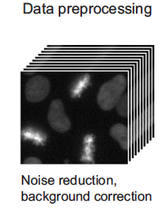
Machine Learning Pipeline
(Sommer and Gerlich, 2013)

Slide 31
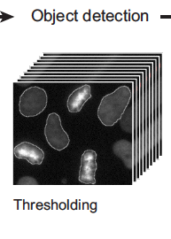
Machine Learning Pipeline
Thresholding: image segmentation method (identify objects vs. background) → optional
(Sommer and Gerlich, 2013)

Slide 32
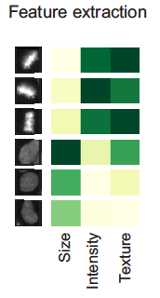
Machine Learning Pipeline
Thresholding: image segmentation method (identify objects vs. background) → optional
(Sommer and Gerlich, 2013)

Slide 33
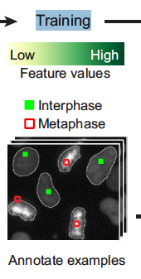
Machine Learning Pipeline
Thresholding: image segmentation method (identify objects vs. background) → optional
(Sommer and Gerlich, 2013)

Slide 34
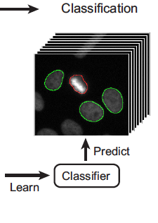
Machine Learning Pipeline
(Sommer and Gerlich, 2013)

Slide 35
Machine Learning Pipeline
Prediction of pixel, object, or image classes
(Sommer and Gerlich, 2013)

Slide 36
Machine Learning Pipeline
Prediction of pixel, object, or image classes
(Sommer and Gerlich, 2013)

Slide 37
Supervised Machine Learning
Majority of machine learning in cell biology uses supervised learning

Slide 38
Supervised Machine Learning
Majority of machine learning in cell biology uses supervised learning
Supervised: possible outputs/labels are already known

Slide 39

Supervised Machine Learning
Majority of machine learning in cell biology uses supervised learning
Supervised: possible outputs/labels are already known
Given the instance space X and label space Y, there exists some target function $y=f\left(x\right)$that outputs the correct $y$ in the label space

Slide 40

Supervised Machine Learning
Majority of machine learning in cell biology uses supervised learning
Supervised: possible outputs/labels are already known
Given the instance space X and label space Y, there exists some target function $y=f\left(x\right)$that outputs the correct $y$ in the label space
$f\left(x\right)$ is learned from a given set of $\left(x, y\right)$ pairs

Slide 41
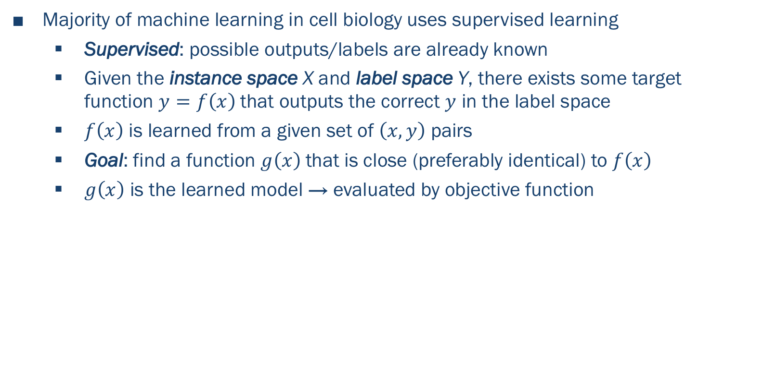
Supervised Machine Learning
Majority of machine learning in cell biology uses supervised learning
Supervised: possible outputs/labels are already known
Given the instance space X and label space Y, there exists some target function $y=f\left(x\right)$that outputs the correct $y$ in the label space
$f\left(x\right)$ is learned from a given set of $\left(x, y\right)$ pairs
Goal: find a function $g\left(x\right)$that is close (preferably identical) to $f\left(x\right)$
$g\left(x\right)$ is the learned model → evaluated by objective function

Slide 42
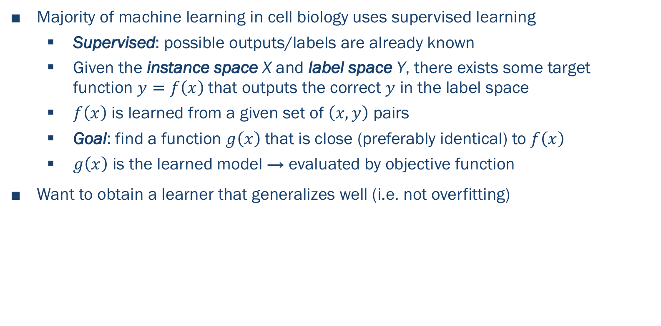
Supervised Machine Learning
Majority of machine learning in cell biology uses supervised learning
Supervised: possible outputs/labels are already known
Given the instance space X and label space Y, there exists some target function $y=f\left(x\right)$that outputs the correct $y$ in the label space
$f\left(x\right)$ is learned from a given set of $\left(x, y\right)$ pairs
Goal: find a function $g\left(x\right)$that is close (preferably identical) to $f\left(x\right)$
$g\left(x\right)$ is the learned model → evaluated by objective function
Want to obtain a learner that generalizes well (i.e. not overfitting)

Slide 43
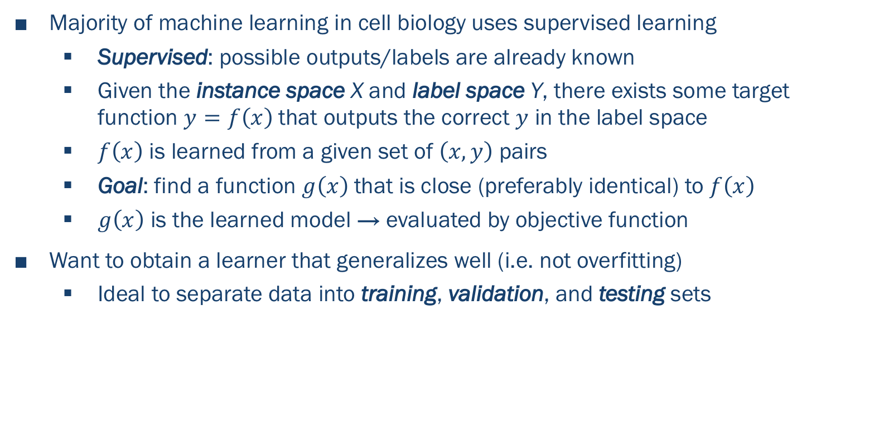
Supervised Machine Learning
Majority of machine learning in cell biology uses supervised learning
Supervised: possible outputs/labels are already known
Given the instance space X and label space Y, there exists some target function $y=f\left(x\right)$that outputs the correct $y$ in the label space
$f\left(x\right)$ is learned from a given set of $\left(x, y\right)$ pairs
Goal: find a function $g\left(x\right)$that is close (preferably identical) to $f\left(x\right)$
$g\left(x\right)$ is the learned model → evaluated by objective function
Want to obtain a learner that generalizes well (i.e. not overfitting)
Ideal to separate data into training, validation, and testing sets

Slide 44
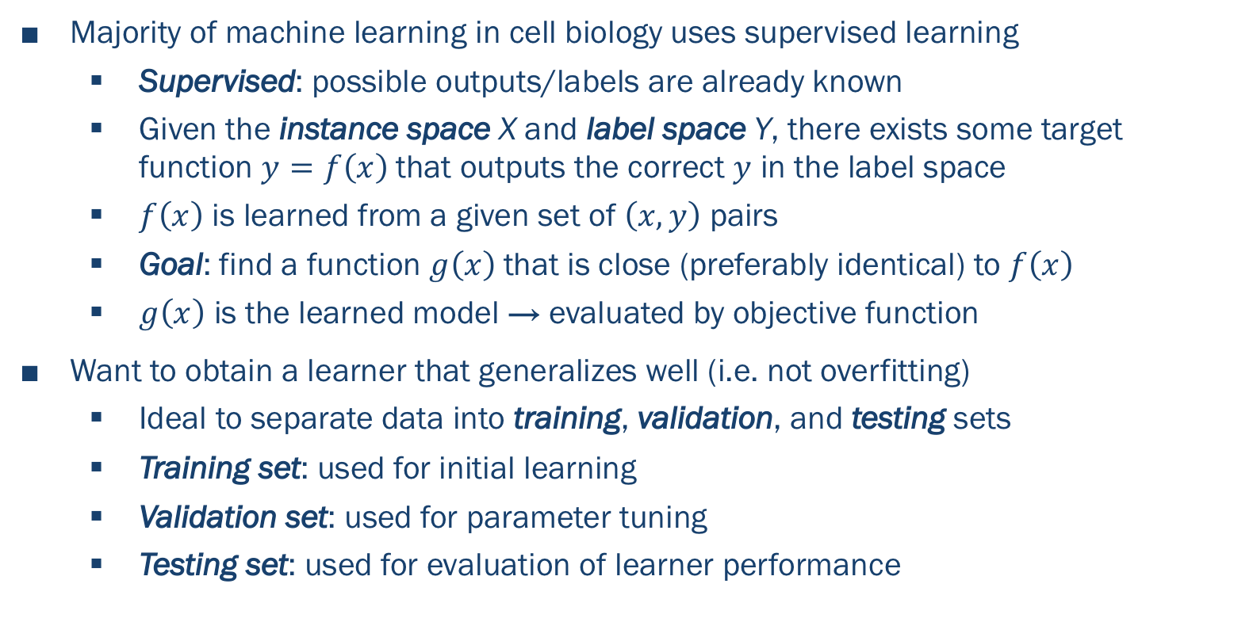
Supervised Machine Learning
Majority of machine learning in cell biology uses supervised learning
Supervised: possible outputs/labels are already known
Given the instance space X and label space Y, there exists some target function $y=f\left(x\right)$that outputs the correct $y$ in the label space
$f\left(x\right)$ is learned from a given set of $\left(x, y\right)$ pairs
Goal: find a function $g\left(x\right)$that is close (preferably identical) to $f\left(x\right)$
$g\left(x\right)$ is the learned model → evaluated by objective function
Want to obtain a learner that generalizes well (i.e. not overfitting)
Ideal to separate data into training, validation, and testing sets
Training set: used for initial learning
Validation set: used for parameter tuning
Testing set: used for evaluation of learner performance

Slide 45

Models Underlying Machine Learning
Generative Model: learns the joint probability $P\left(x, y\right)$ and predicts the conditional probability $P\left(y | x\right)$ using Bayes Theorem

Slide 46
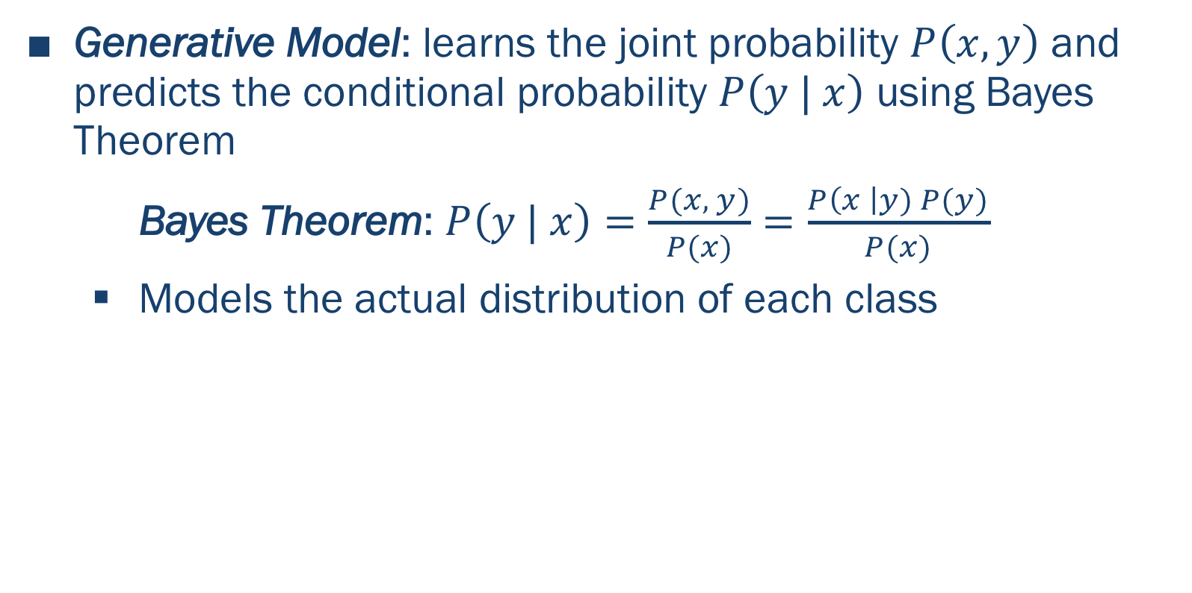
Models Underlying Machine Learning
Generative Model: learns the joint probability $P\left(x, y\right)$ and predicts the conditional probability $P\left(y | x\right)$ using Bayes Theorem
Bayes Theorem: $P\left(y | x\right)=\frac{P(x, y)}{P(x)}=\frac{P\left(x \right|y) P(y)}{P(x)}$
Models the actual distribution of each class

Slide 47
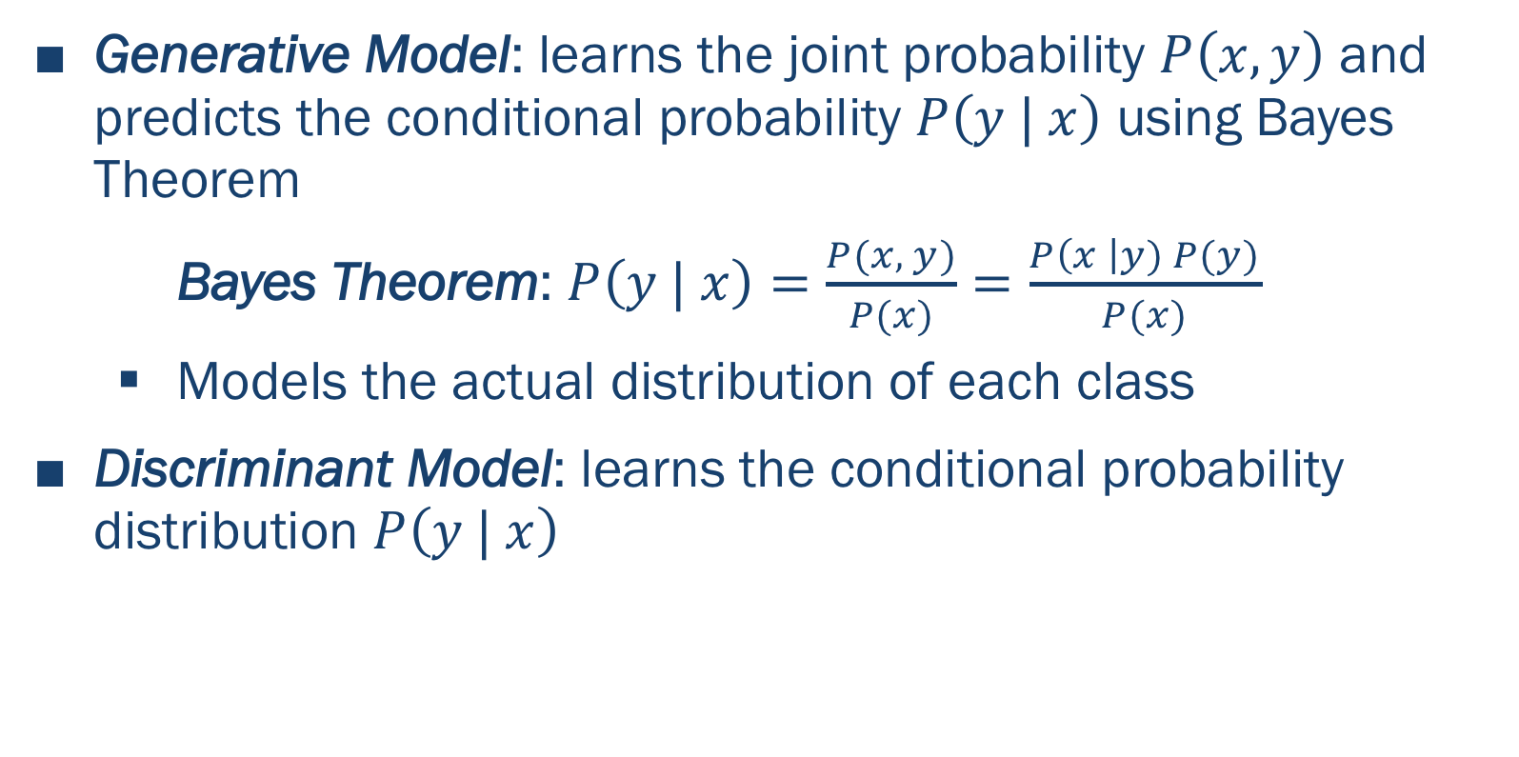
Models Underlying Machine Learning
Generative Model: learns the joint probability $P\left(x, y\right)$ and predicts the conditional probability $P\left(y | x\right)$ using Bayes Theorem
Bayes Theorem: $P\left(y | x\right)=\frac{P(x, y)}{P(x)}=\frac{P\left(x \right|y) P(y)}{P(x)}$
Models the actual distribution of each class
Discriminant Model: learns the conditional probability distribution $P\left(y | x\right)$

Slide 48
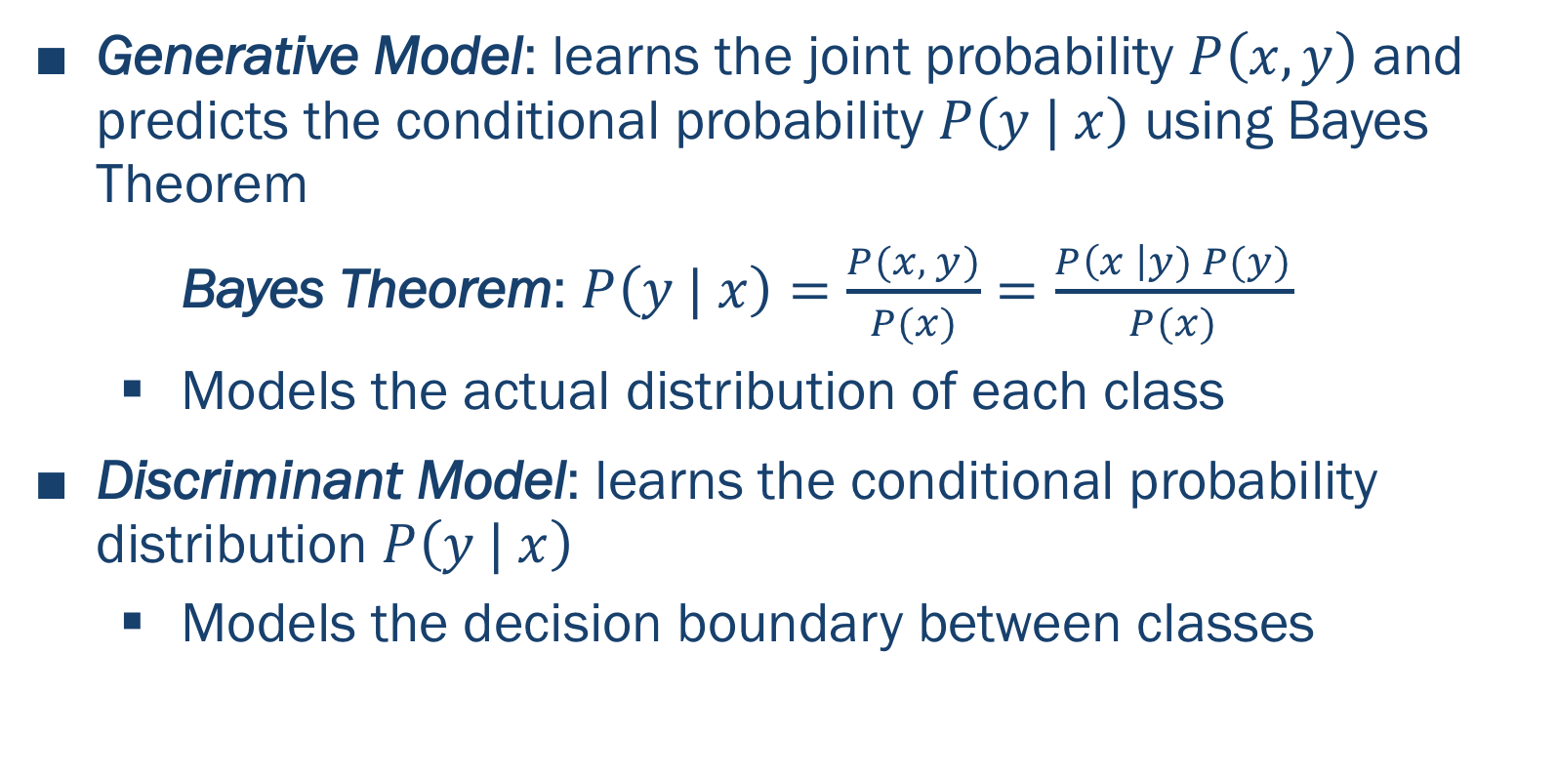
Models Underlying Machine Learning
Generative Model: learns the joint probability $P\left(x, y\right)$ and predicts the conditional probability $P\left(y | x\right)$ using Bayes Theorem
Bayes Theorem: $P\left(y | x\right)=\frac{P(x, y)}{P(x)}=\frac{P\left(x \right|y) P(y)}{P(x)}$
Models the actual distribution of each class
Discriminant Model: learns the conditional probability distribution $P\left(y | x\right)$
Models the decision boundary between classes

Slide 49
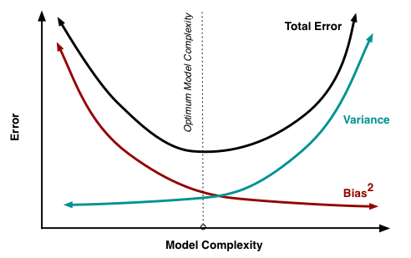
Optimization of Machine Learning
High bias: strong preference for learner to follow internal model assumptions
http://scott.fortmann-roe.com/docs/BiasVariance.html

Slide 50
Optimization of Machine Learning
High bias: strong preference for learner to follow internal model assumptions
Low bias: learner able to adapt to training data
May lose generalizability
http://scott.fortmann-roe.com/docs/BiasVariance.html

Slide 51
Optimization of Machine Learning
High bias: strong preference for learner to follow internal model assumptions
Low bias: learner able to adapt to training data
May lose generalizability
Low variance: classifiers produce similar decision boundaries when applied to different training data
http://scott.fortmann-roe.com/docs/BiasVariance.html

Slide 52
Optimization of Machine Learning
High bias: strong preference for learner to follow internal model assumptions
Low bias: learner able to adapt to training data
May lose generalizability
Low variance: classifiers produce similar decision boundaries when applied to different training data
High variance: classifiers have more adaptive decision boundaries that are susceptible to “noise” present in training data
http://scott.fortmann-roe.com/docs/BiasVariance.html

Slide 53
Optimization of Machine Learning
High bias: strong preference for learner to follow internal model assumptions
Low bias: learner able to adapt to training data
May lose generalizability
Low variance: classifiers produce similar decision boundaries when applied to different training data
High variance: classifiers have more adaptive decision boundaries that are susceptible to “noise” present in training data
Goal: optimize the bias-variance tradeoff and minimize total error
http://scott.fortmann-roe.com/docs/BiasVariance.html

Slide 54
Unsupervised Machine Learning
Instances where it’s not possible to define training data set
Unsupervised machine learning algorithms infer patterns from the dataset without reference to labeled outcomes

Slide 55
Unsupervised Machine Learning
Instances where it’s not possible to define training data set
Unsupervised machine learning algorithms infer patterns from the dataset without reference to labeled outcomes
Becomes more difficult to define objective function
Objective function developed using clustering techniques that aim to minimize the distance between objects within clusters and maximize distances between objects in different clusters

Slide 56
Examples of Supervised and Unsupervised Machine Learning Algorithms
Supervised machine learning algorithms
Support vector machines → linear or radial/Gaussian kernels
Adaptive boosting (AdaBoost) → sensitive to noisy data/outliers
Random forest → ideal for high-dimensional data, computationally efficient

Slide 57
Examples of Supervised and Unsupervised Machine Learning Algorithms
Supervised machine learning algorithms
Support vector machines → linear or radial/Gaussian kernels
Adaptive boosting (AdaBoost) → sensitive to noisy data/outliers
Random forest → ideal for high-dimensional data, computationally efficient
Unsupervised machine learning algorithms
K-means clustering → iterative process
Gaussian mixture modeling → extends k-means clustering to account for more complex distributions of the data
Hierarchical clustering → based solely on the distance between data points
Dimensionality reduction → PCA, ICA, MDS, feature selection

